Slide 1

Southern Minnesota Independent Living Enterprises & Services, Inc.
Center for Independent Living
Empowering People with Disabilities Since 1990!

Slide 2
Mission
SMILES Center for Independent Living (CIL) is a nonprofit organization committed to providing a wide array of services to assist individuals with disabilities to live independently, pursue meaningful goals, and have the same opportunities and choices as all persons.

Slide 3
Independent Living Philosophy
Self Determination
  Right to make life decisions for oneself
  Choose from available options
  Define success on one’s own terms
Ed Roberts
  Polio
  University of California at Berkeley
  Berkeley Center for Independent Living

Slide 4
Disability Awareness
Natural Consequence of Life
  Physical or Mental/Emotional Impairment
  Record of Such Impairment
  Regarded as Having an Impairment

Slide 5
Major Life Activity
Caring for Oneself
Performing Manual Tasks
Walking
Seeing
Hearing
Speaking
Breathing
Learning
Standing, Lifting
Thinking, Concentrating, Interacting with Others

Slide 6
Disability Awareness
Not the same as Person’s Impairment(s)
  Disability Etiquette
  Person First Language
    Person with a disability
    Person who uses a wheelchair
    Person who has Cerebral Palsy

Slide 7
Disability Is
Related to the Capacity of the Community to Provide Access and Inclusion
    Architectural
        Ramps and curb cuts
        Signs in Braille
        Audible traffic signals
    Attitudinal
        Talking to the person
    Administrative
        Alternate formats for paperwork

Slide 8
Independent Living Philosophy
Cross Disability
  Centers provide services to all disability groups/populations
Community Based
  Programs, services, and activities are provided to people with disabilities within the communities where they reside
Consumer Control
  Centers are mainly run by people with disabilities including board, staff and volunteers who themselves have been successful in establishing independent lifestyles

Slide 9
Theory of Self Determination
Autonomy
  What the person intends to accomplish
Competencies
  Skills or abilities needed to accomplish intent
Relatedness
  Quality of support for acquiring skills to accomplish intent

Slide 10
Theory of Self Determination
Autonomy + Competencies + Relatedness

Slide 11
Qualities of Relatedness
Knowledge of a person’s unique gifts
Tolerance and acceptance of differences
Skills for accessibility (attitudes, architecture, communications)

Slide 12
Successful Support
Everybody wants their self determination to be successful
Support bridges that mile between Self Determination and Success

Slide 13
SMILES
Why is SMILES the longest word in the dictionary?

Slide 14
SMILES
Because there is a MILE between the two “S’s!”

Slide 15
SMILES
Self Determination to live independently in the community requires
Membership in the Community, increases access to
Inclusion, and provides opportunities for a
Life of Choice and Options, which lead to
Experience that is necessary for
Success

Slide 16
Consumer Education
Everybody has Human Rights to be treated with dignity and respect.
You have the right to speak for yourself and make your own life decisions.
Self Advocacy: speaking up for yourself
Self Determination: deciding for yourself
Dignity: having your human rights respected
Self Respect: self advocacy for your own human rights and dignity
Independence: A person’s own choice or decision
Dignity of Risk: The right to learn from failure

Slide 17
Self Determination
Successful people know what they want to do in life. They decide to succeed.
They find out what their choices are, and what skills and abilities they need so they can act on their choices. They empower themselves to be successful.
People use their power to get the success they want. They leverage their skills.

Slide 18
SMILES Self Determination
Choices + Skill = Empowerment

Slide 19
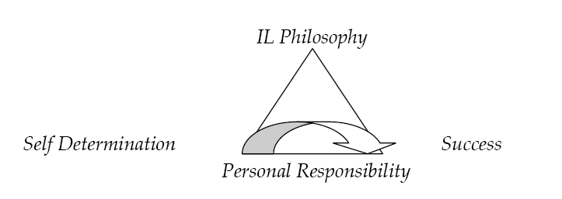
From Philosophy to Success

Slide 20
SMILES History
SMILES Opened in 1990
Certified Center for Independent Living
  consumer-controlled
  community-based
  cross-disability
  nonresidential
  private, nonprofit agencies
  designed and operated within local communities by individuals with disabilities

Slide 21
CIL as a Unique Model
Medical / Social / Rehab
  Evolved from Protection Model vs
  Self Determination
ARC / LEEP / MRCI / HMC / VR / SSB-HD
  Licensed or Certified for specific focus
  IL Philosophy is collaborative (whole person)
    Choices + Skills = Empowerment

Slide 22
Residential Models
Private Home self and family support
Private Home with services
  Health care coverage
  Home and Community Based Services
Group Residential Housing
Institutional Care

Slide 23
Qualities of Support
Knowledge of a person’s unique gifts
Tolerance and acceptance of differences
Skills for accessibility (attitudes, architecture, communications)

Slide 24
CIL Four Core Services
Information and Referral
Systems and Individual Advocacy
Peer Counseling
Independent Living Skills Training

Slide 25
Service Areas
Daily Living
Housing
Transportation
Employment
Education
Recreation
Accessing Community Resources

Slide 26
SMILES CIL Programs
Community Services
Ramp Project
Assistive Technology and Access
  Ramp Project
PCA Choice
Transition From School to Community
Nursing Home Relocation

Slide 27
Advocacy
Advocacy is essential as people with disabilities work to build independent lives
    SMILES provides consumer and community advocacy
    SMILES works with individuals to obtain necessary support services
    SMILES supports efforts to initiate change in the community at large

Slide 28
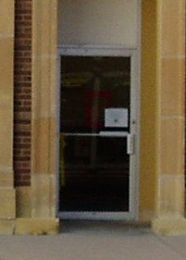
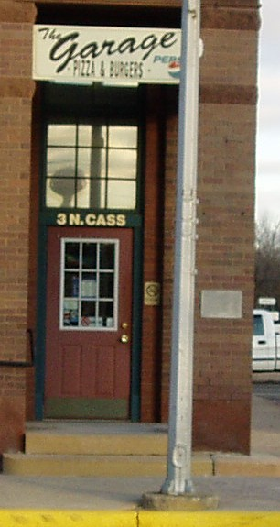
Citizens for Accessibility

Slide 29
IL Skills Training
Individual, or small group basis
  consumer’s home,
  community,
  Assessment Center.
Practical assistance
  increase independence in the community
  resources and options

Slide 30
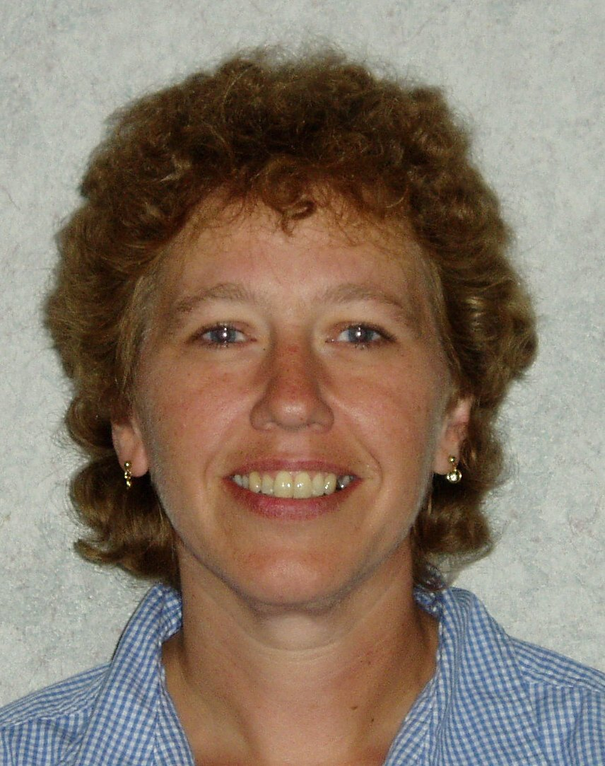
Bonnie Jacobsen
IL Program Manager
  In-service Training
  Consumer Support
  Transition

Slide 31
IL Program Includes:
Socialization
Transportation
Sexuality
Self-advocacy
Health care
Financial management
Community resources
Employment
Safety
Housing
Disability awareness
Recreation and leisure
Educational Opportunities
Homemaking
Food Preparation
Assistive Technology

Slide 32
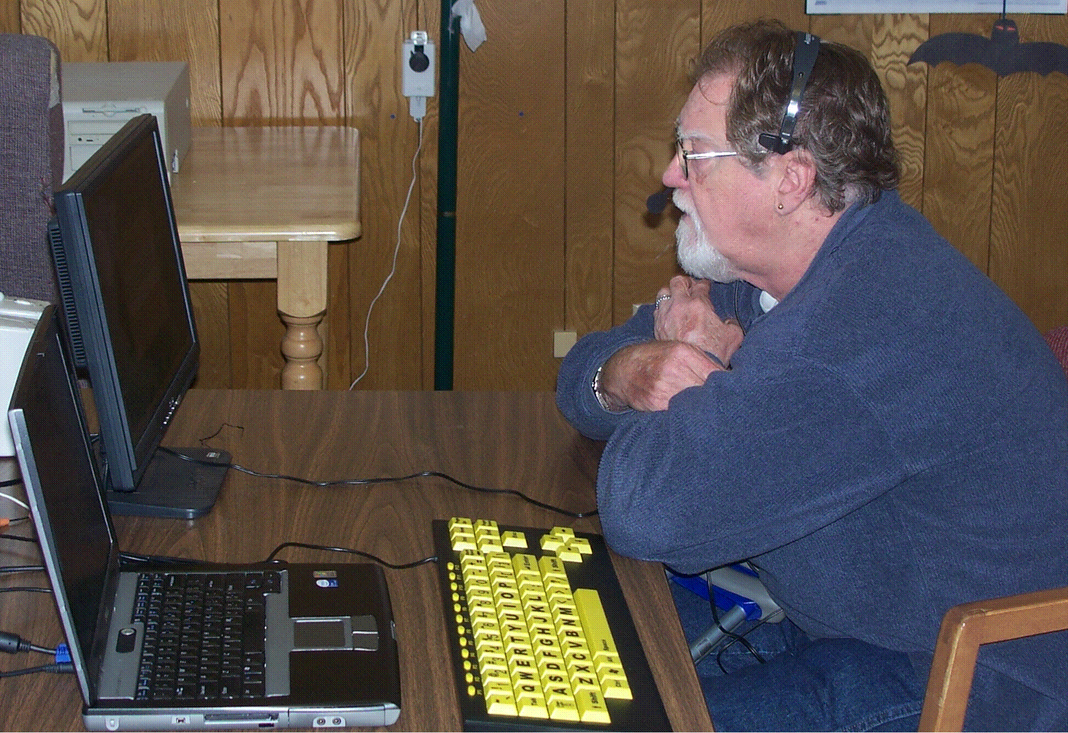
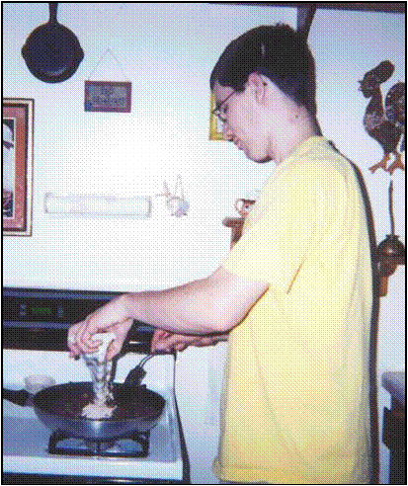
Assessment and Training

Slide 33
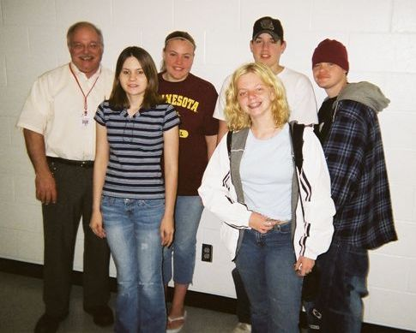
Transition
Transition from school to community is significant for every young person with a disability.
Small group independent living skills training sessions are provided at the school, in the community, and at SMILES.
This program is available to students with disabilities between the ages of 14 and 21.

Slide 34
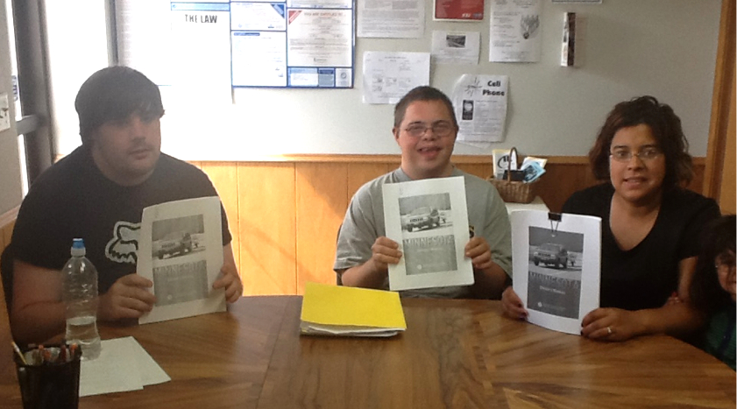
Drivers Education

Slide 35
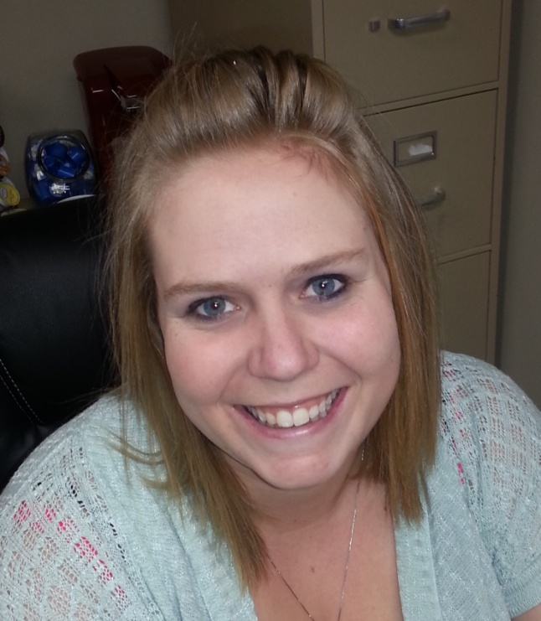
Traci Windschitl
PCA Choice Program Manager
  Individual Choice
  Consumer Control
  Fiscal Intermediary
    Certified 2004

Slide 36
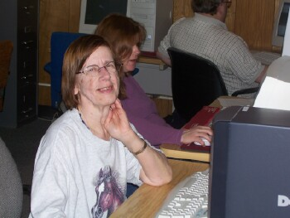
Regional Technology Center
Access the Internet
Computer Training & Assistance
Computer Access Technology
  Speech Recognition Software
  Low Vision Software
  Large Key Keyboards
  Adaptive Mice
Daily Living Aids
  Dressing Aids
  Adaptive Kitchen Utensils
  Adaptive Devices for Hearing
    Impaired / Vision Impaired

Slide 37
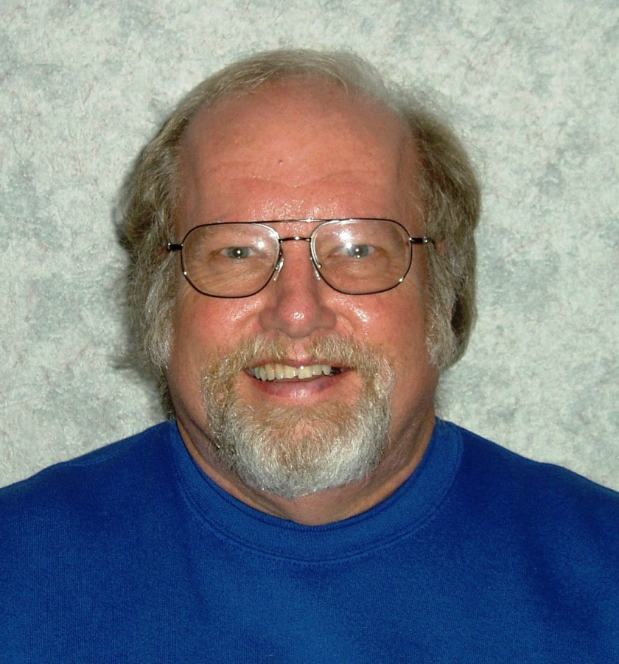
Howard Rosten
I & R Manager
  Information
    and Referral
  Assistive Technology
  Electronics
    Recycling
  Ramp Program

Slide 38
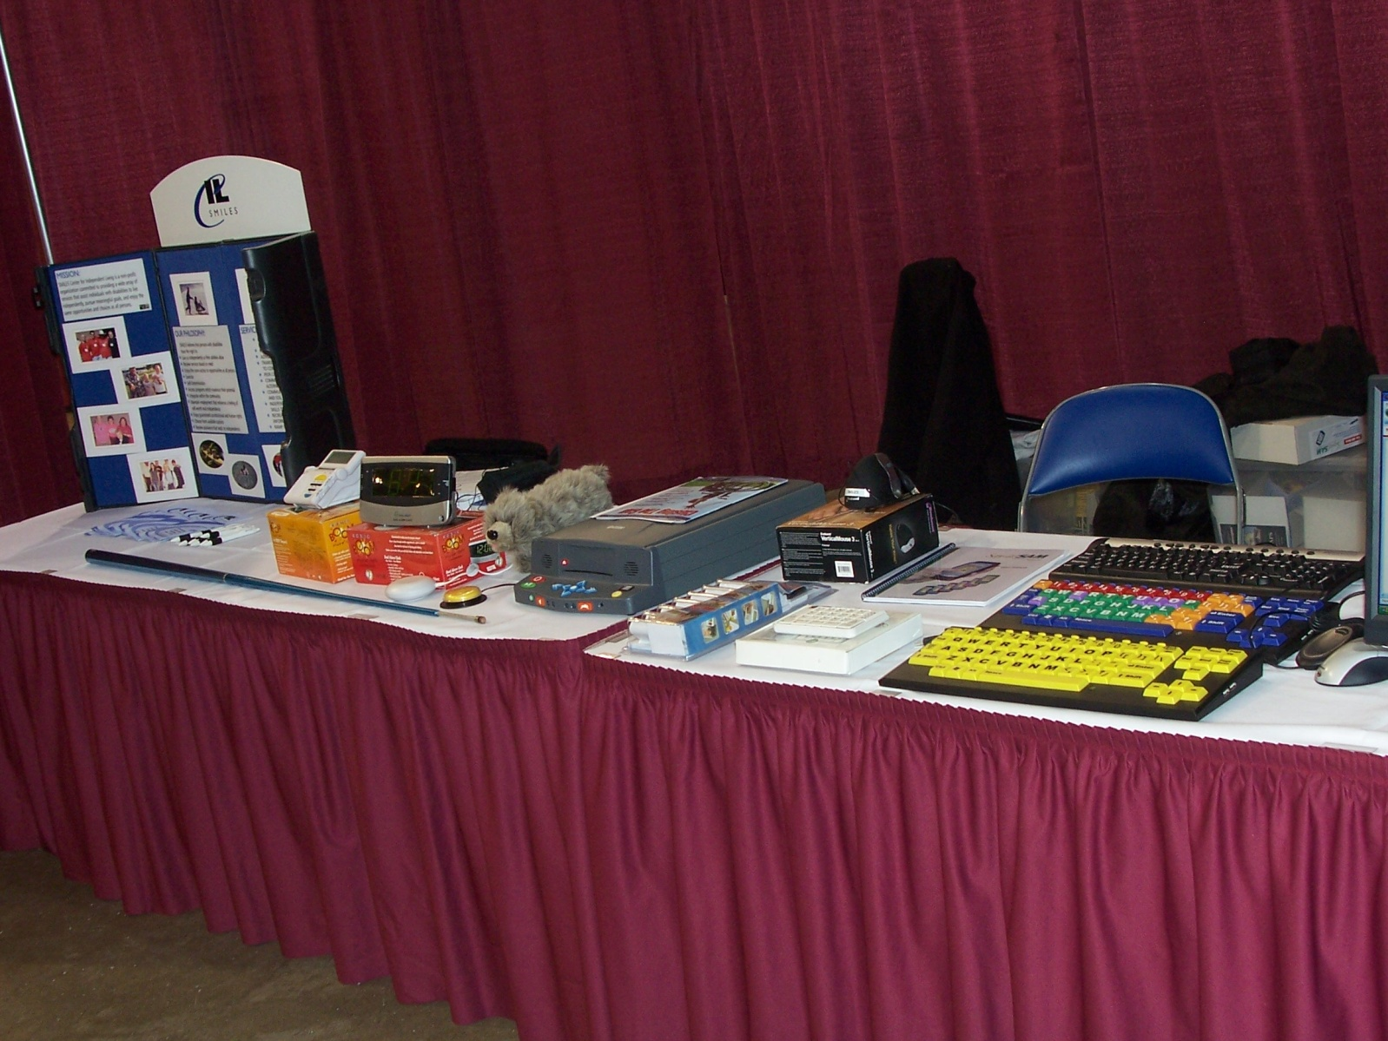
Lending Library

Slide 39
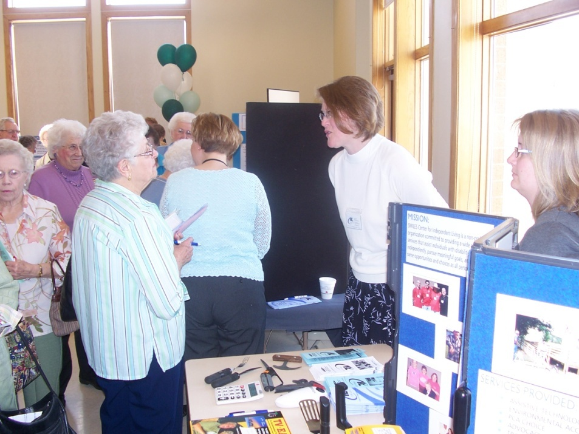
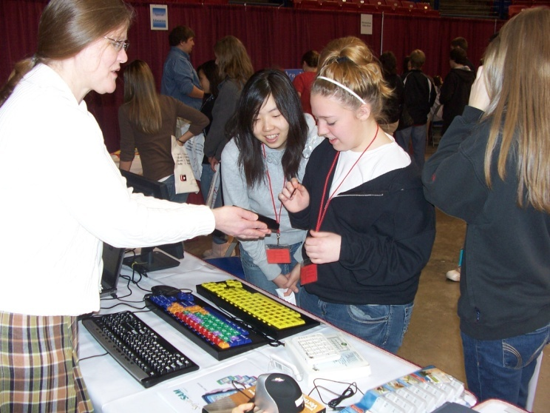
Regional Expos and Clinics

Slide 40
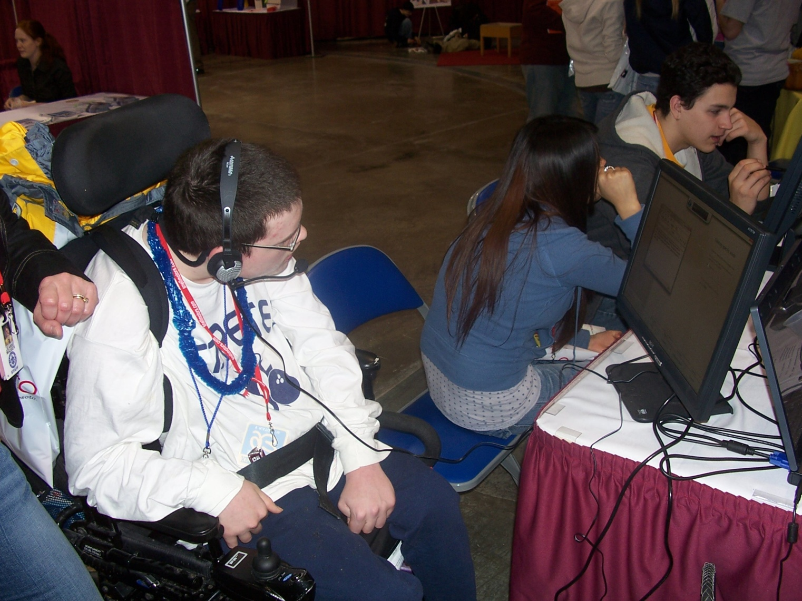
Demonstrations

Slide 41
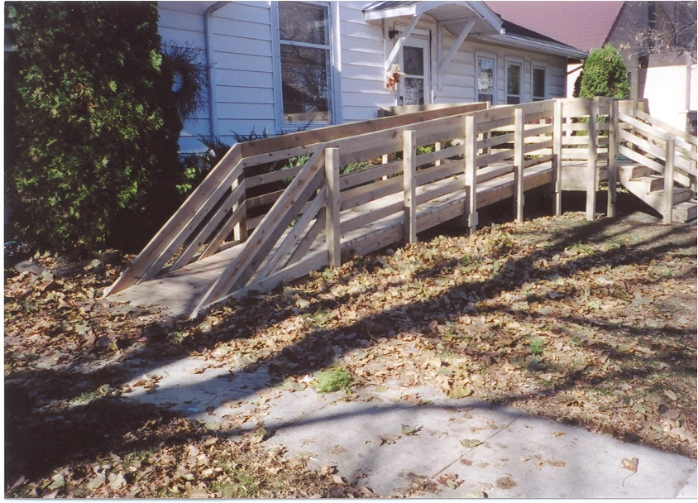
Residential Ramps
Payback for materials only
Based on income and number in household
No interest loans

Slide 42
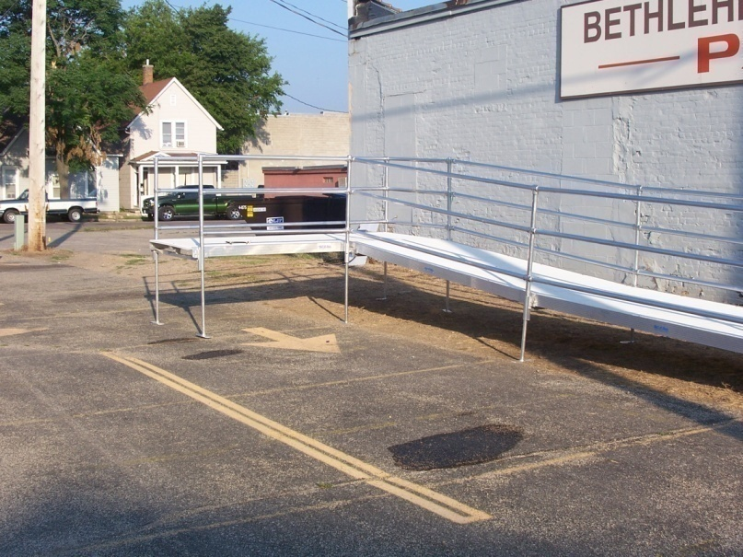
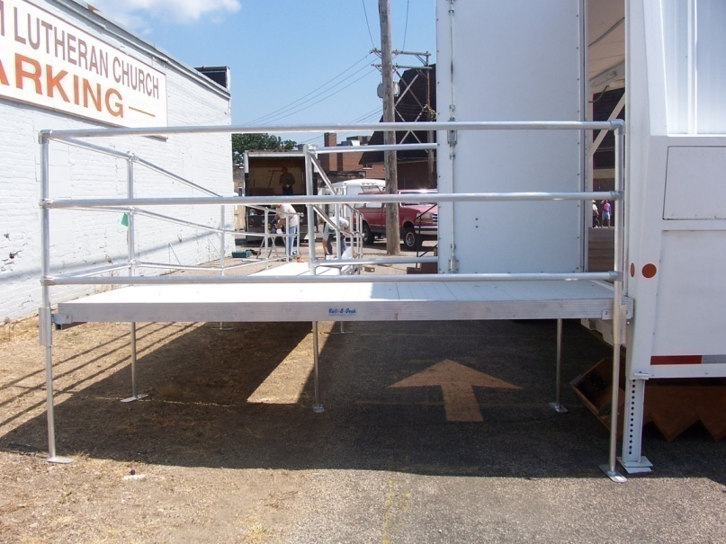
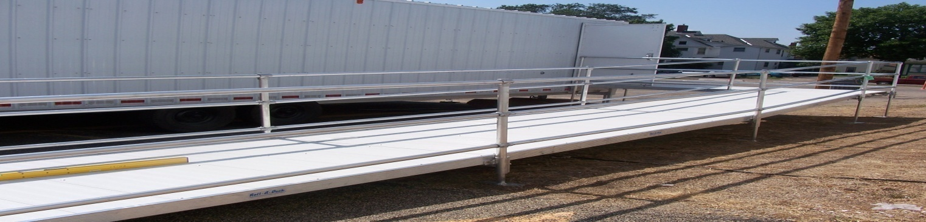
Aluminum Ramps

Slide 43
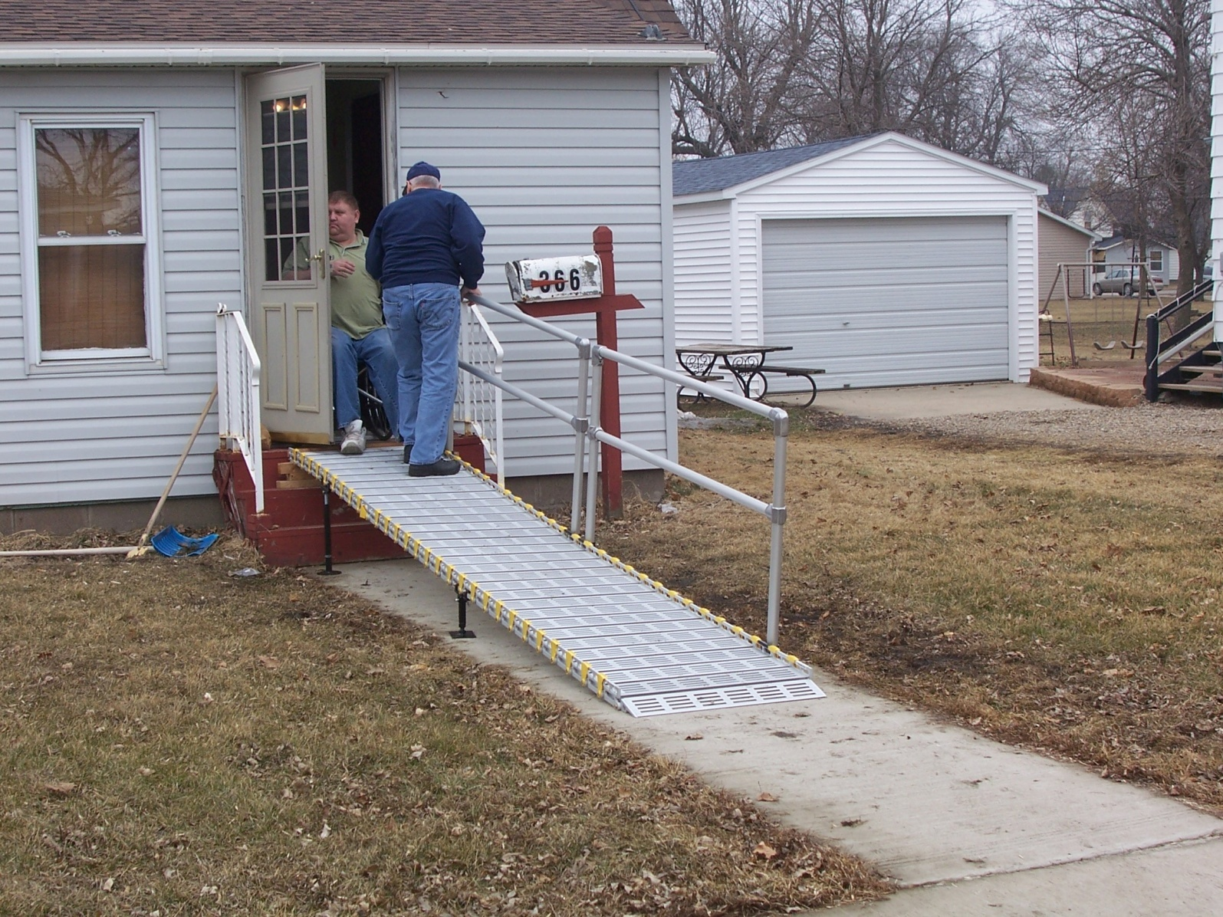
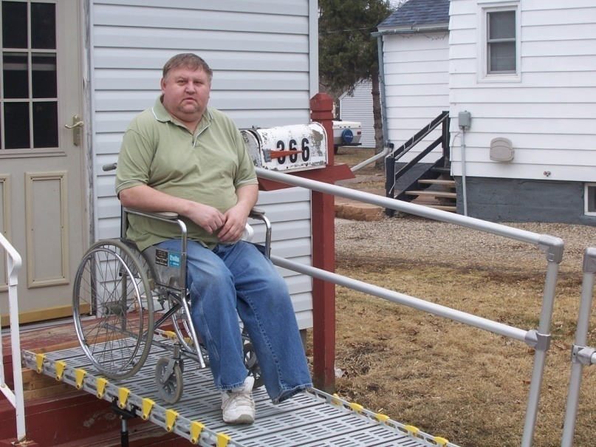
Roll-a-Ramps

Slide 44
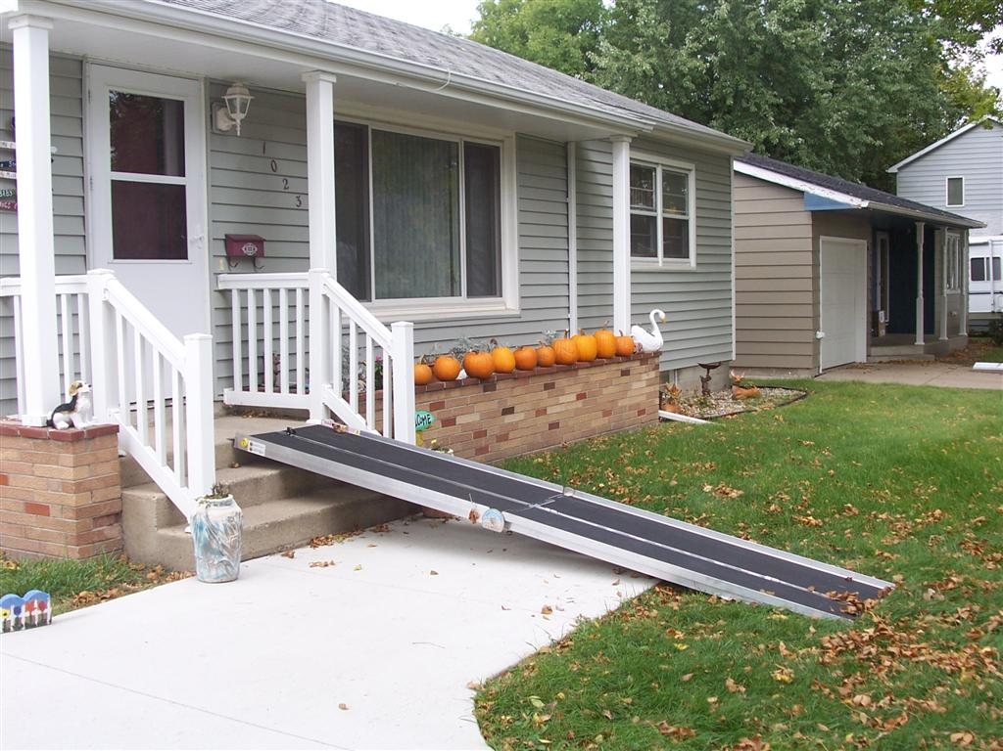
Portable Ramps

Slide 45
Permanent Ramps

Slide 46
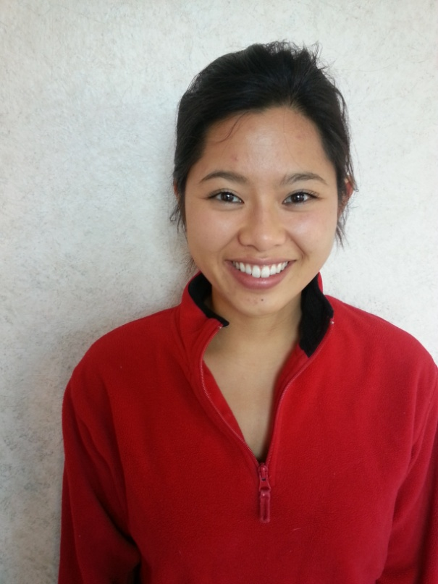
Peer Mentor / Volunteer / Rec
Peer Counseling / Volunteer / Recreation Manager
  Senior Companions
  Volunteer Recruiting, Training and Recognition
  Recreation Programs

Slide 47
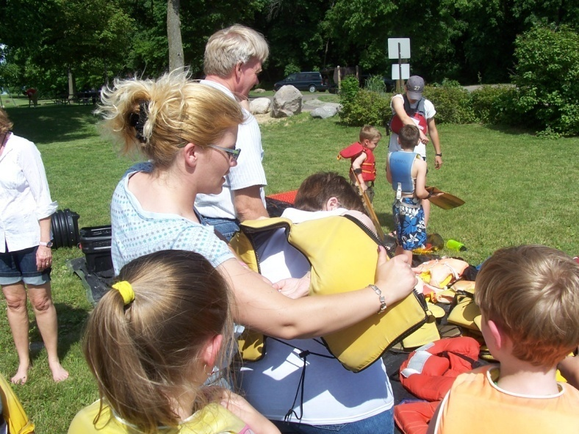
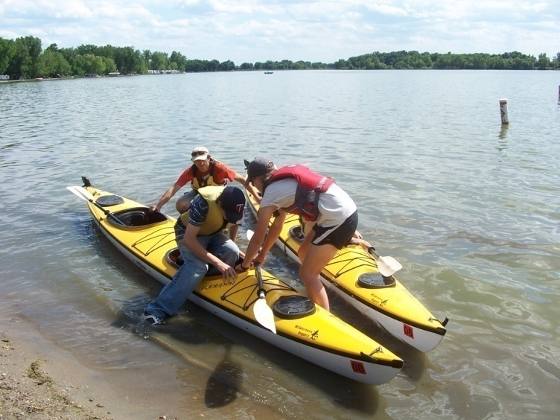
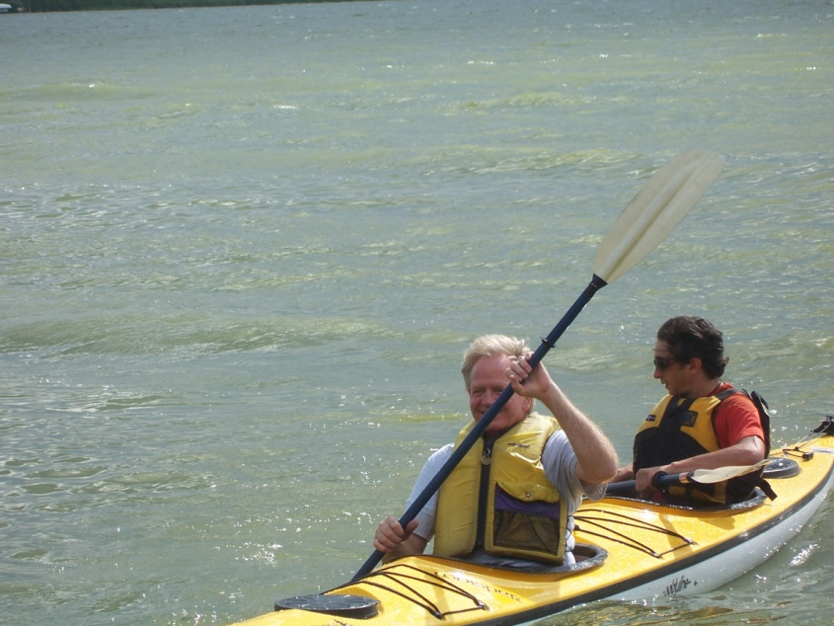
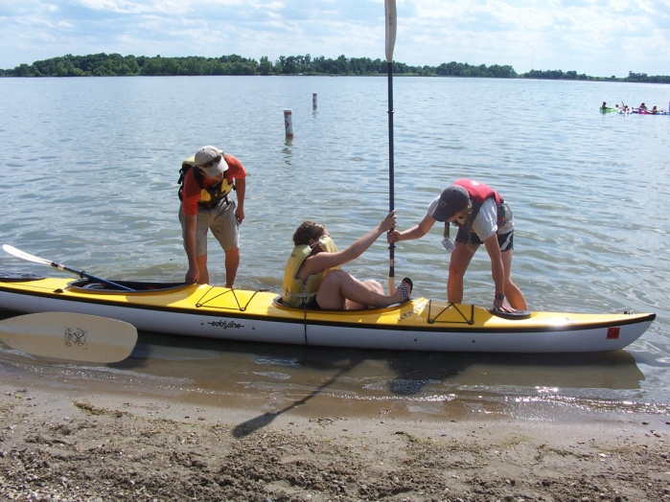
Canoe and Kayak Activities

Slide 48
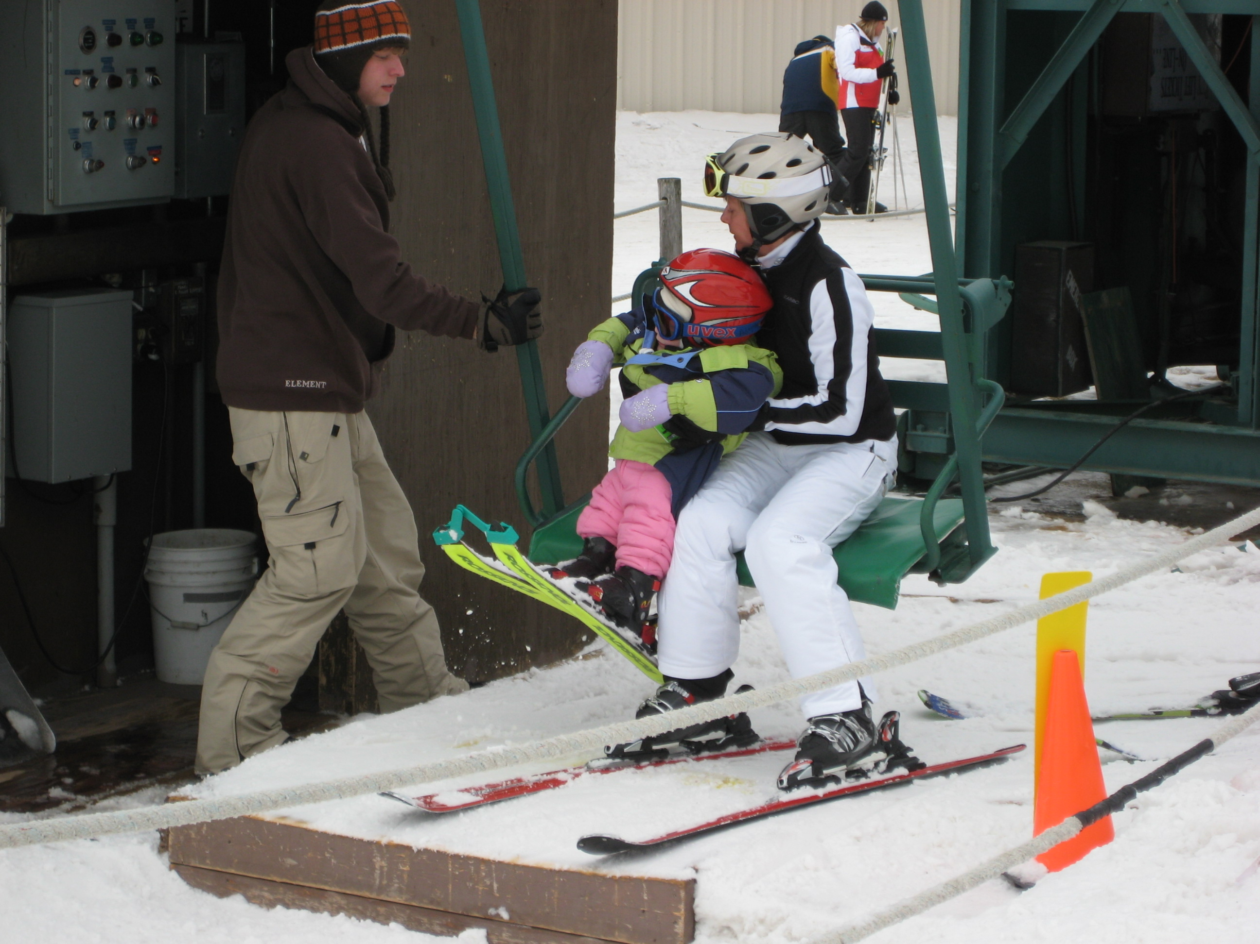
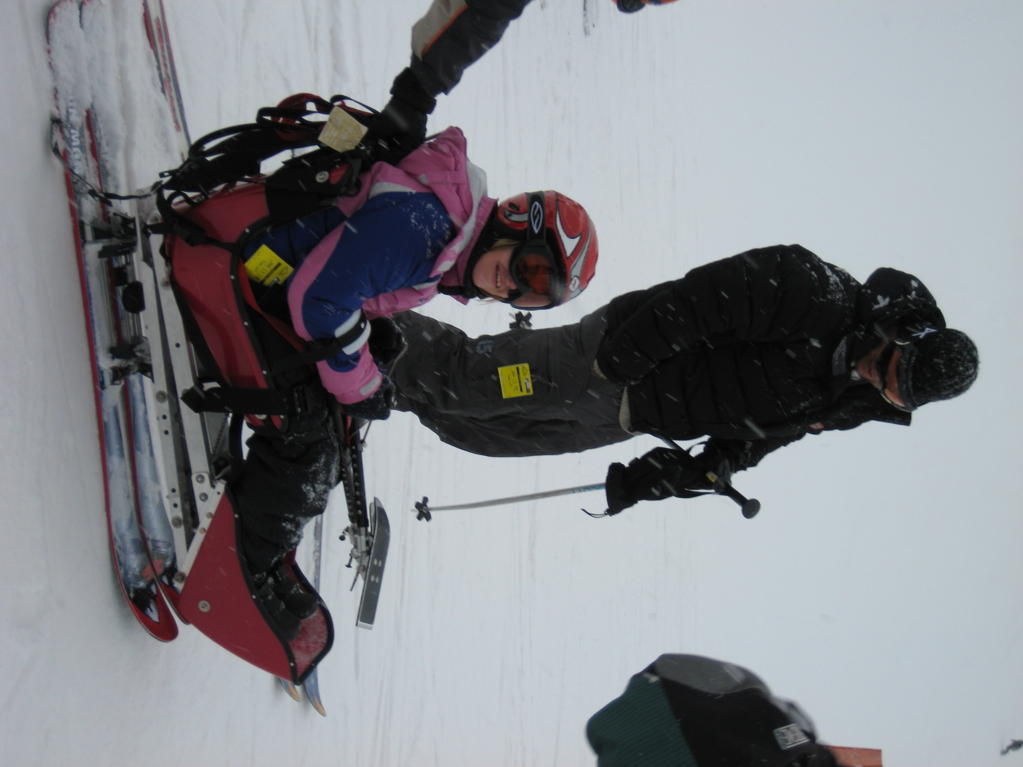
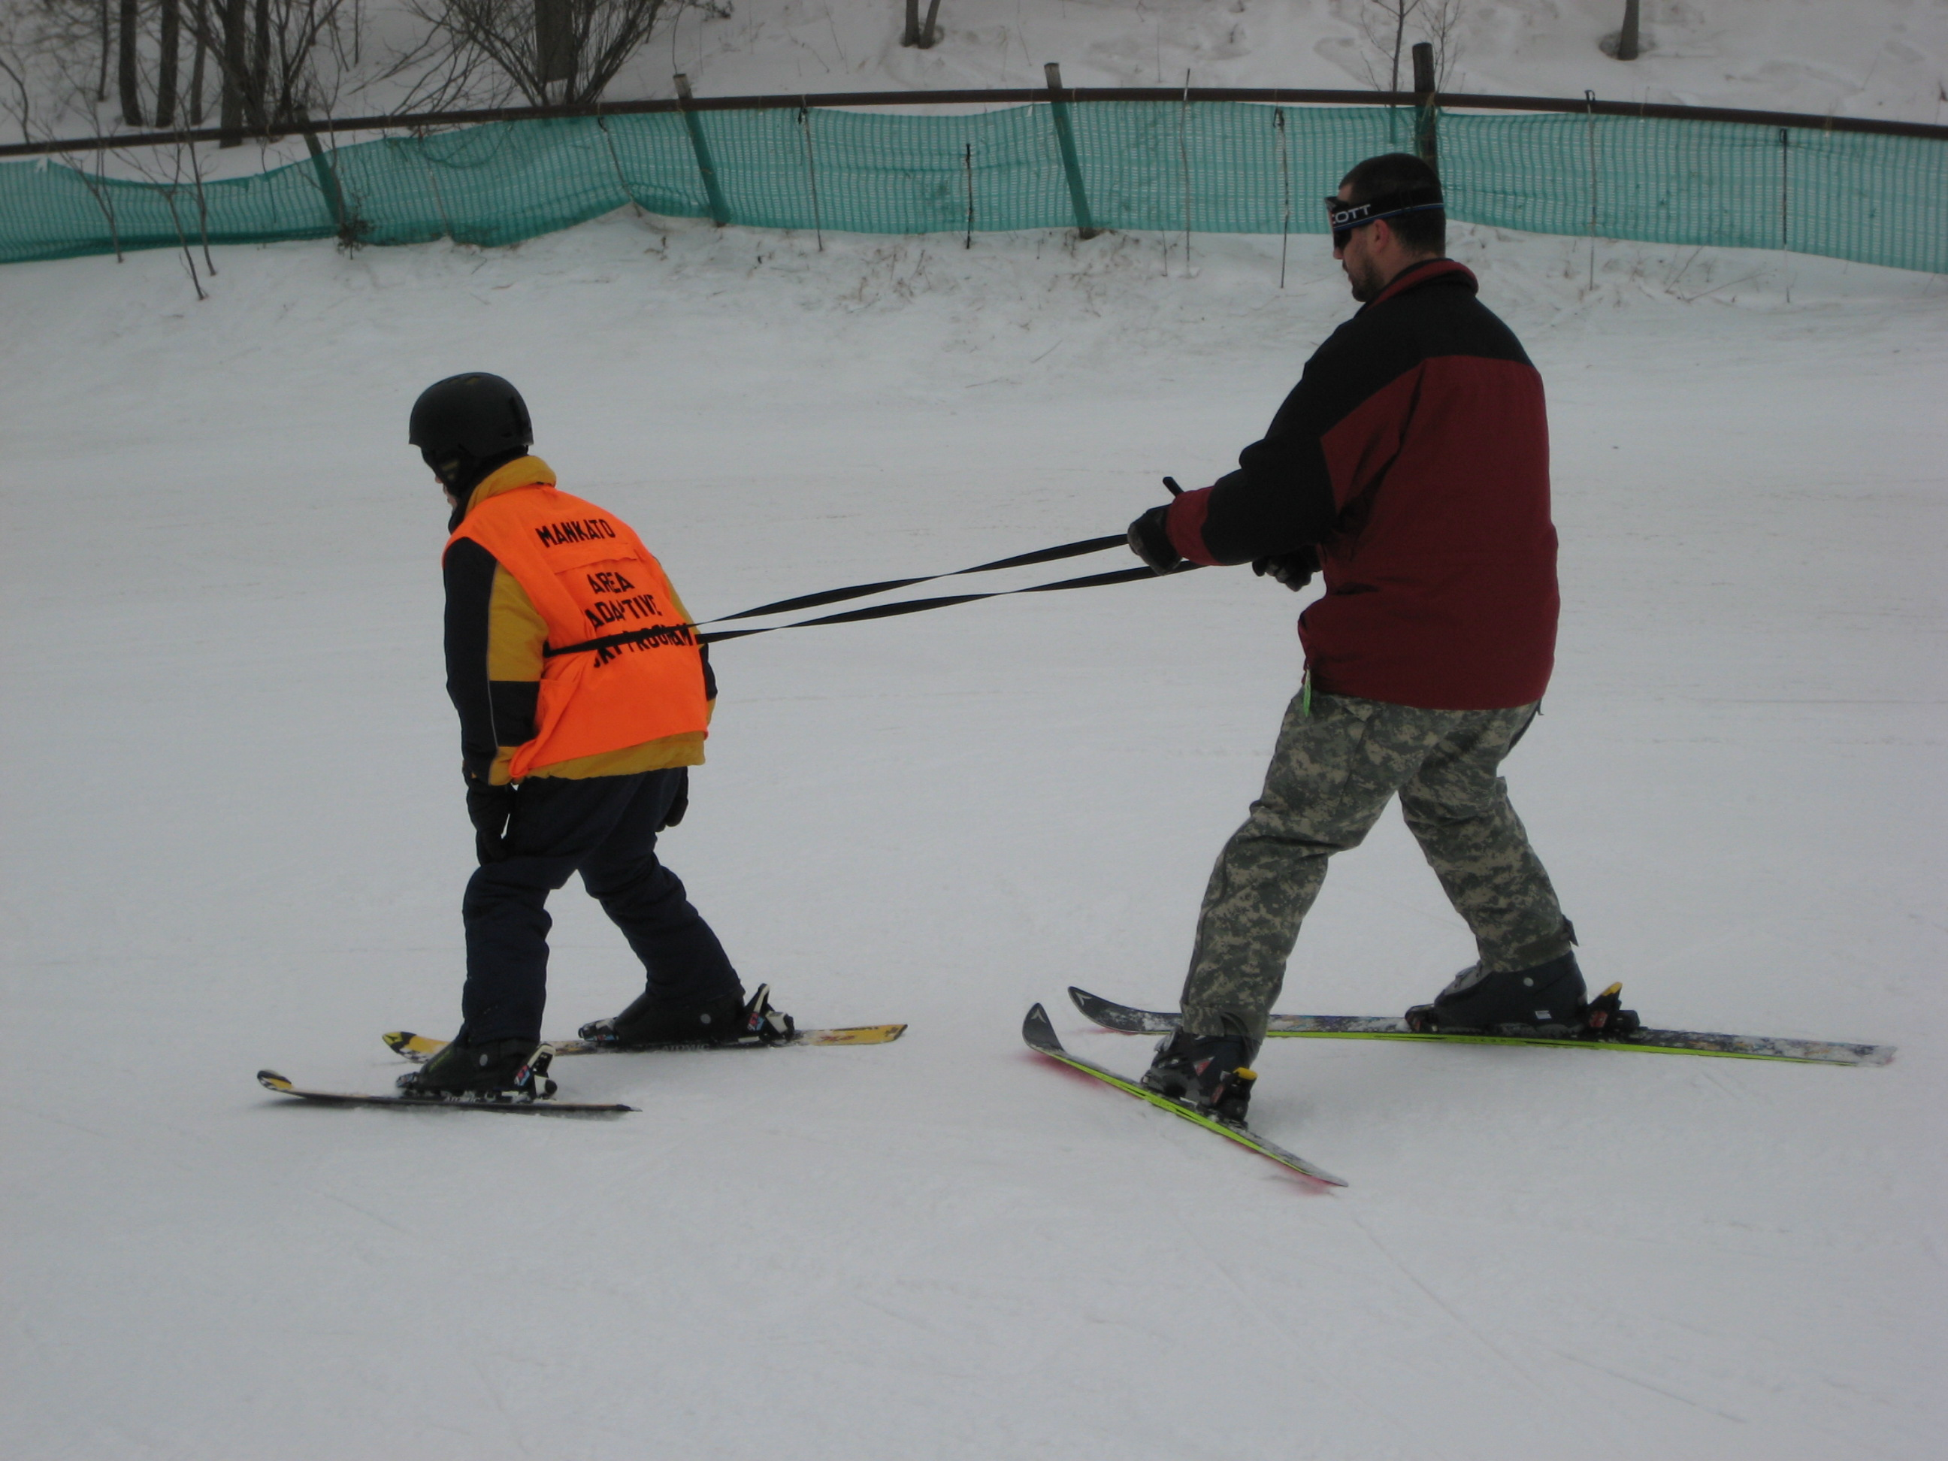
Ski Program

Slide 49
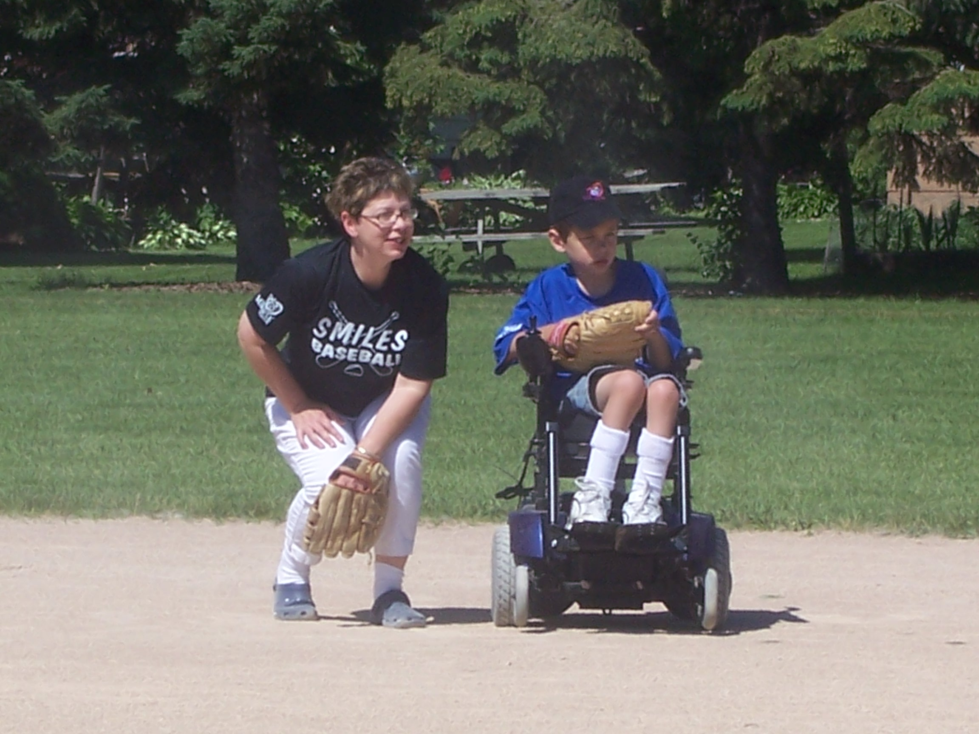
Miracle League Baseball

Slide 50
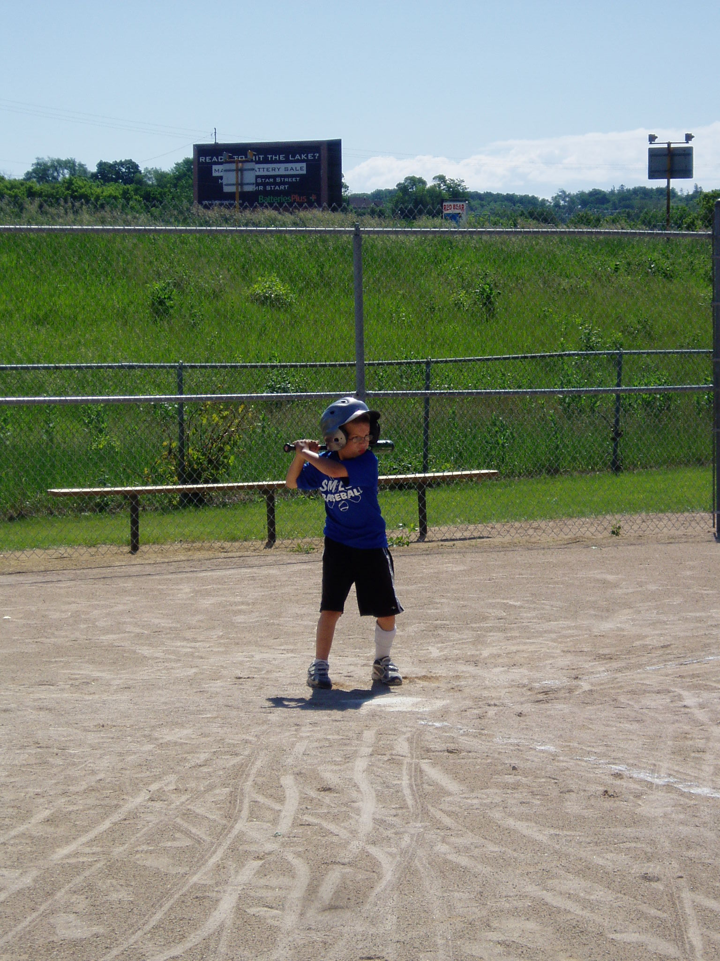
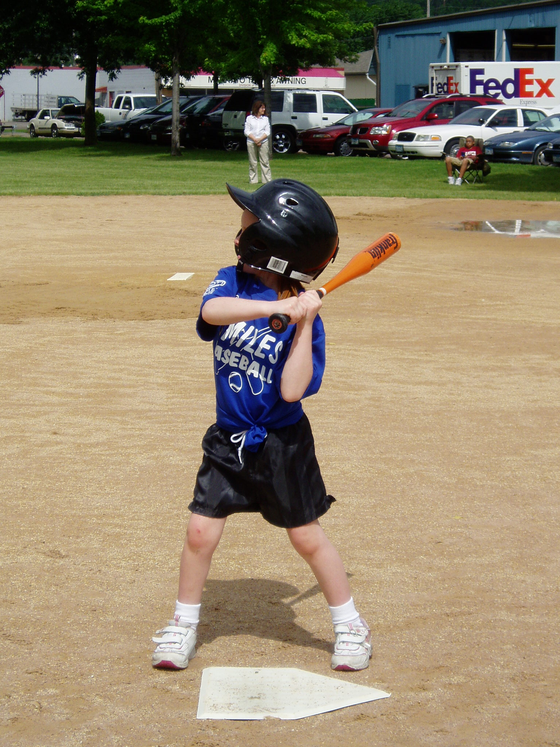
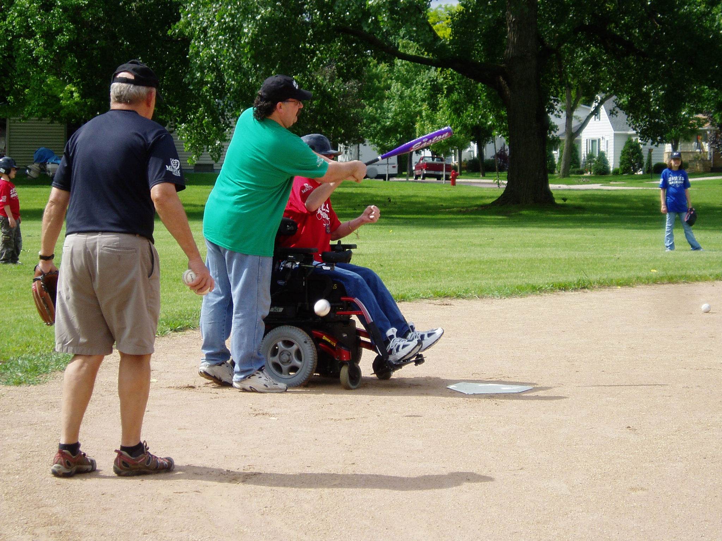

Slide 51
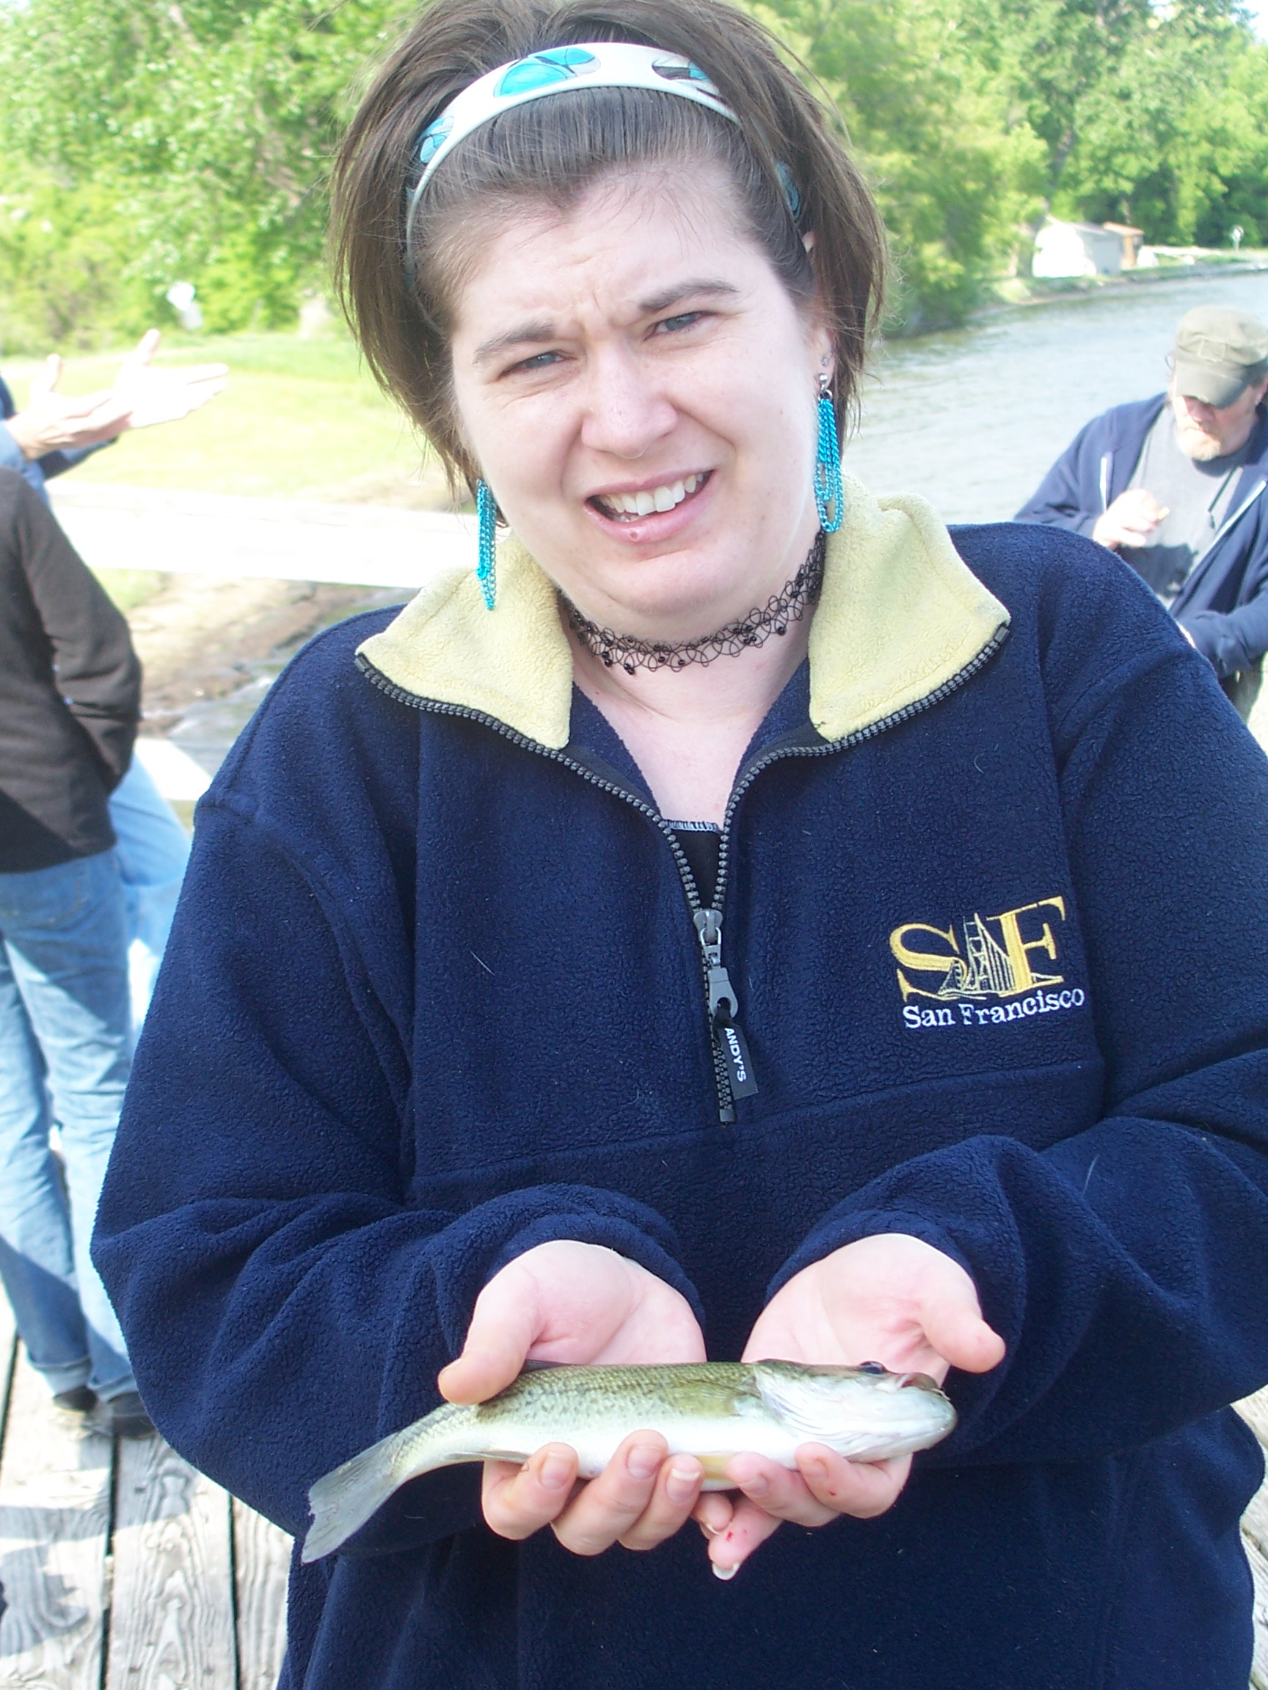
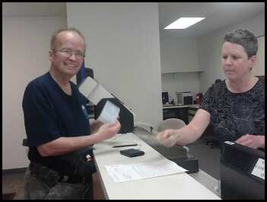
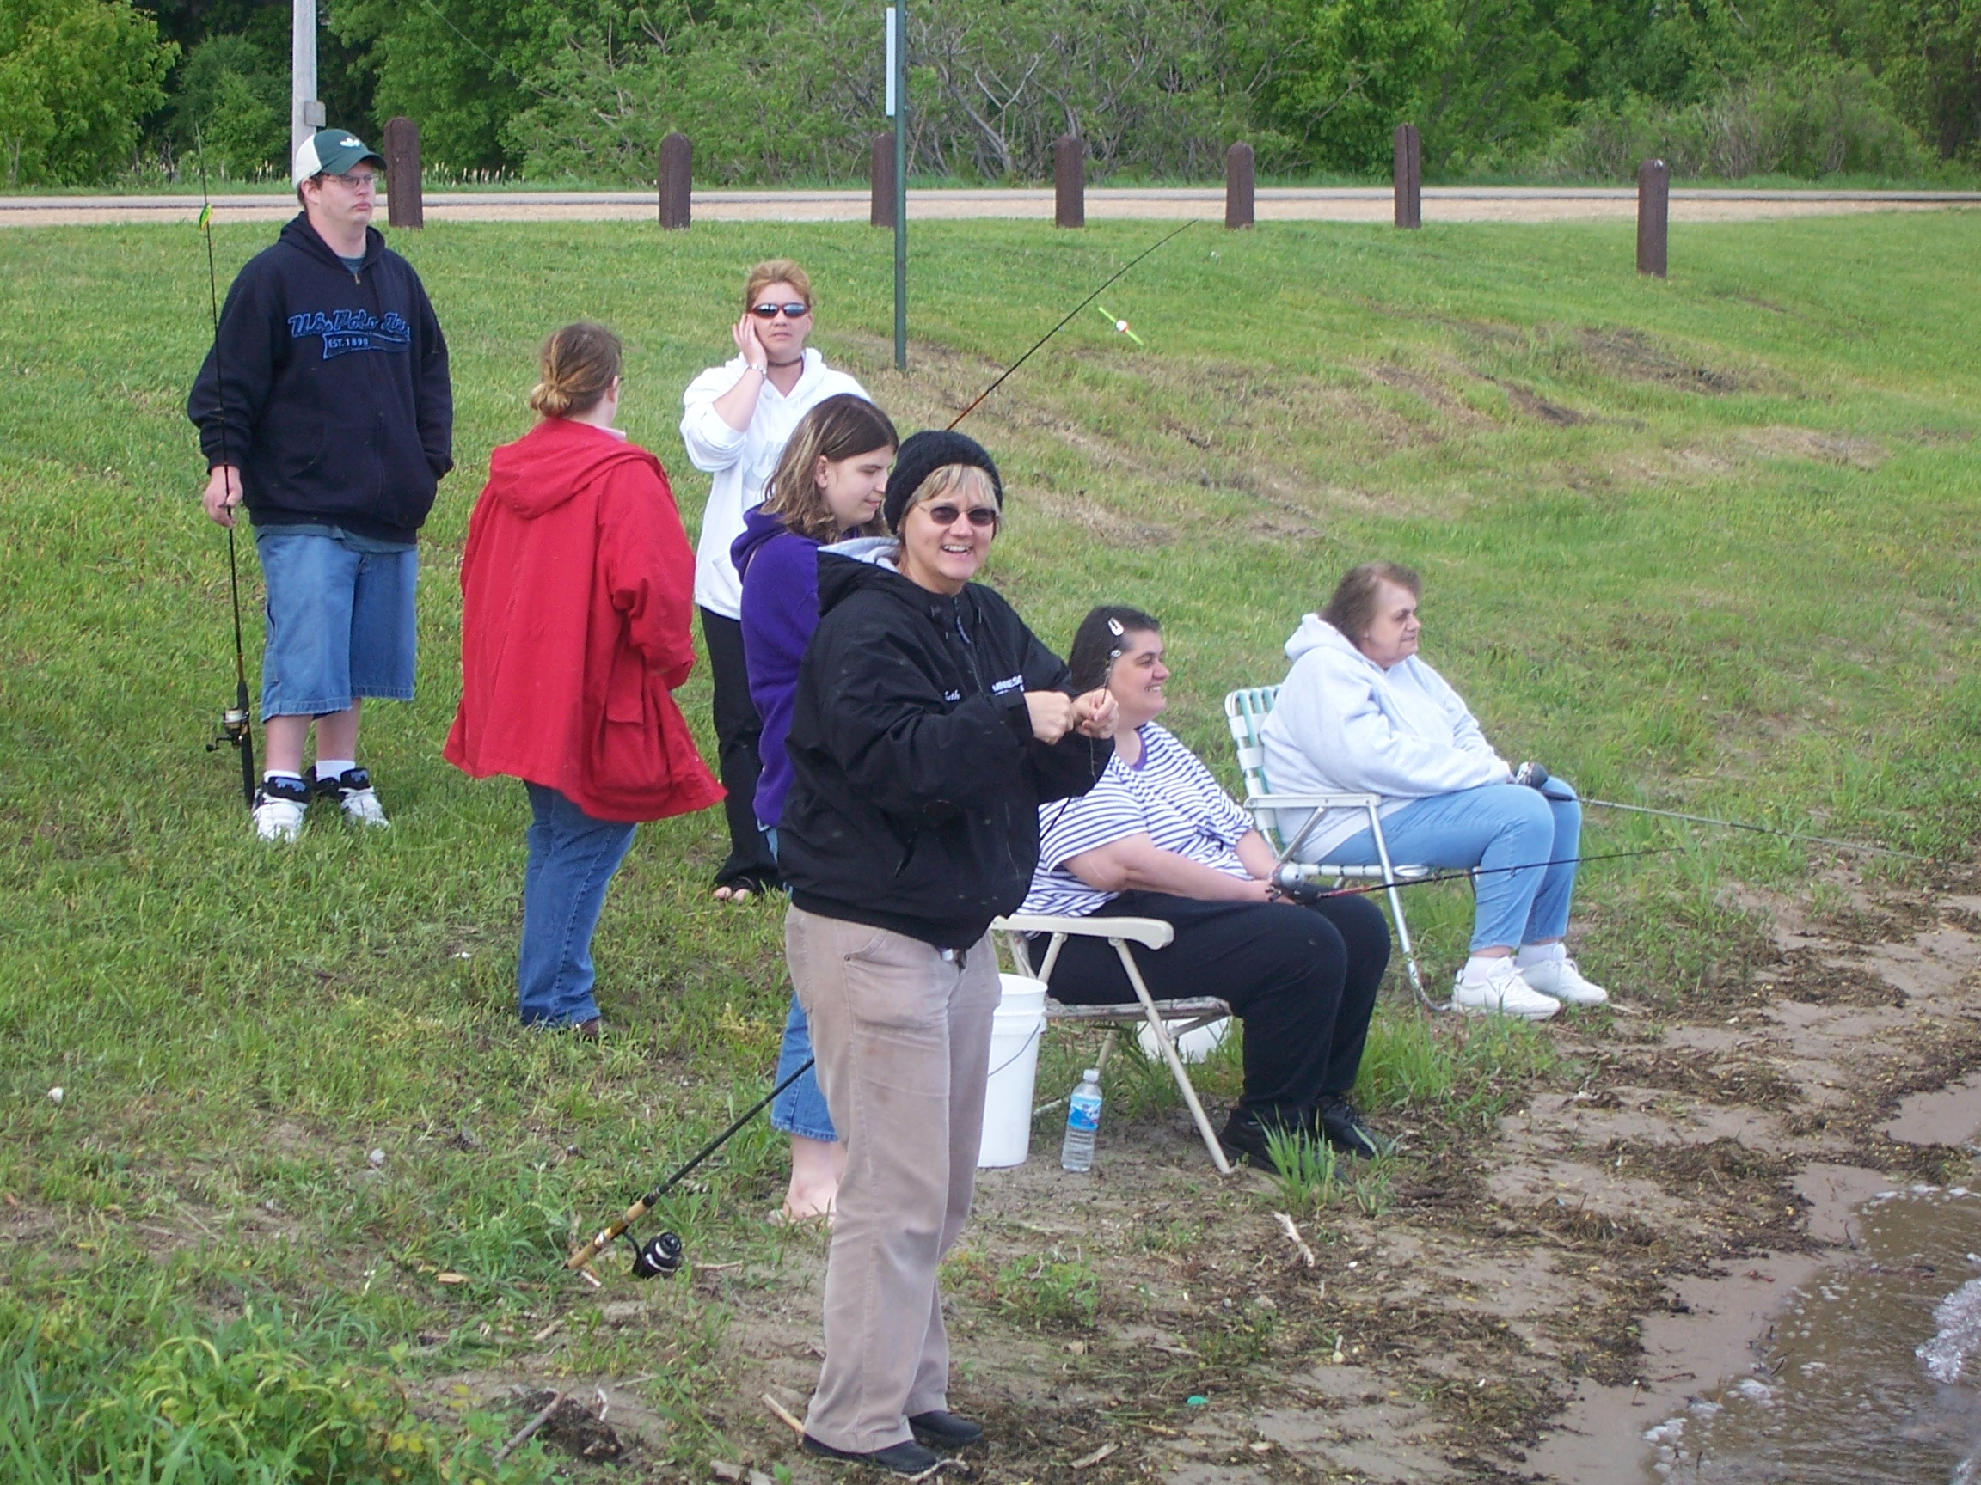
Fishing

Slide 52
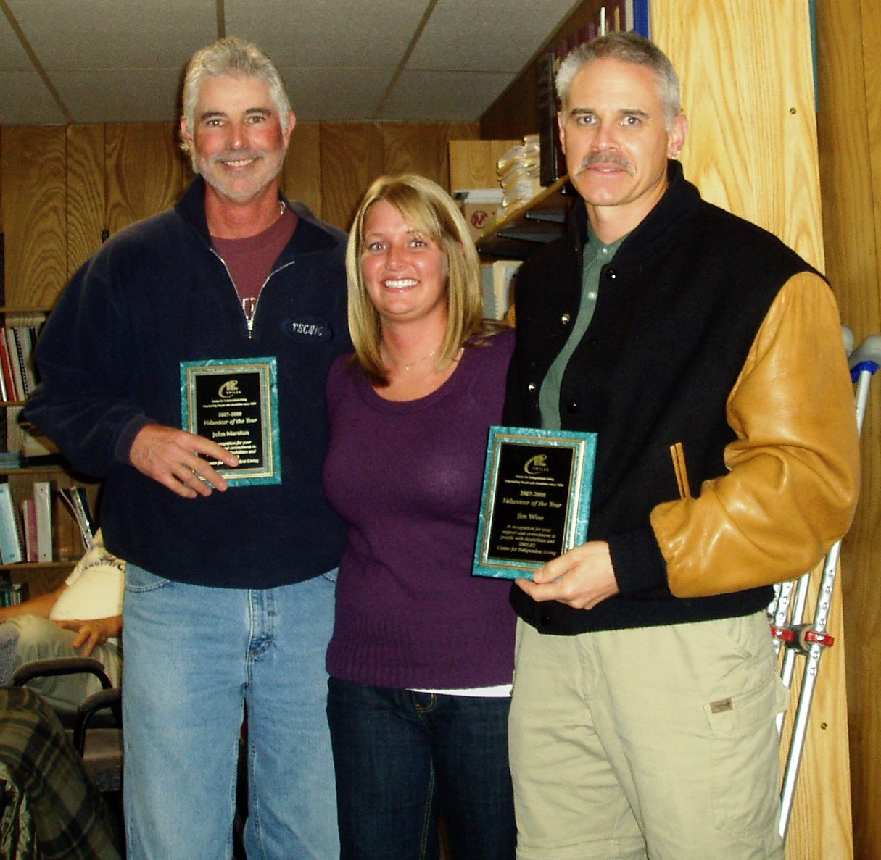
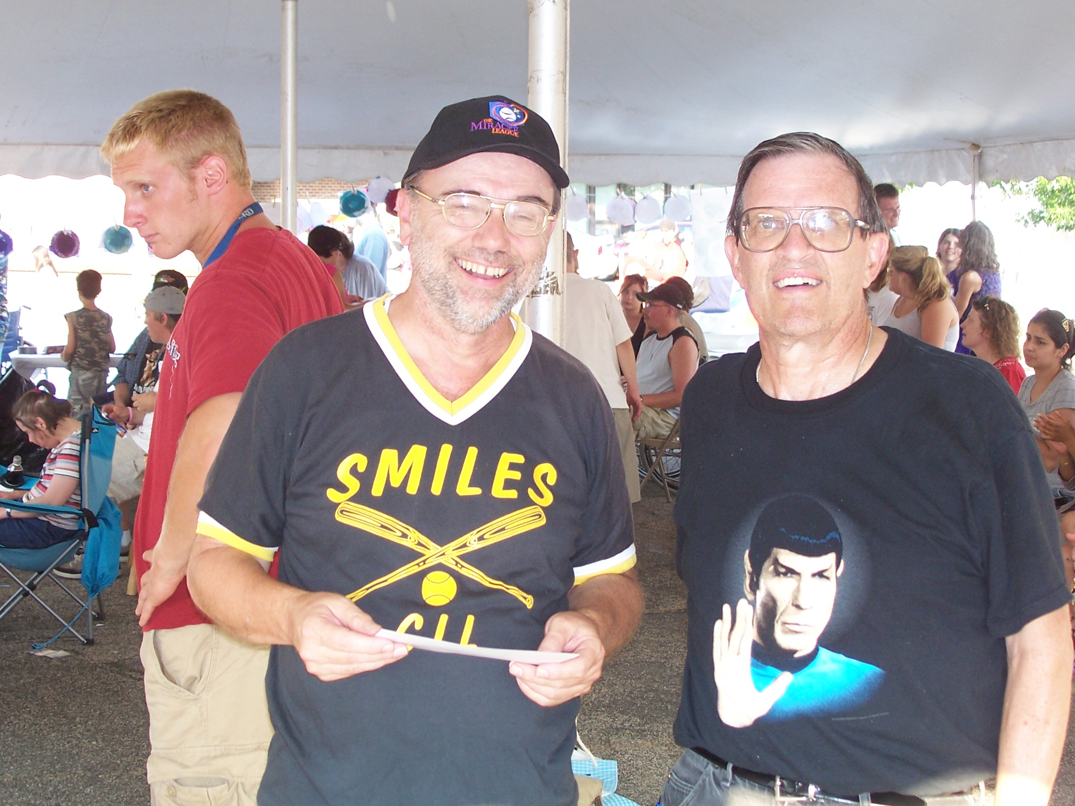
Recreation Volunteers
71 volunteers provided
893 Hours of Fun!

Slide 53

Activity
http://www.mn.gov/mnddc/disability-litigation/videos/disabilityRights.html

Slide 54
SMILES
Choices + Skill = Empowerment

Slide 55
Questions?
www.smilescil.org
Facebook
Twitter
Phone 507-833-1339 or 888-676-6498

Slide 56
Thank You!

